Slide 1


ELECTRICAL TEAM

Slide 2

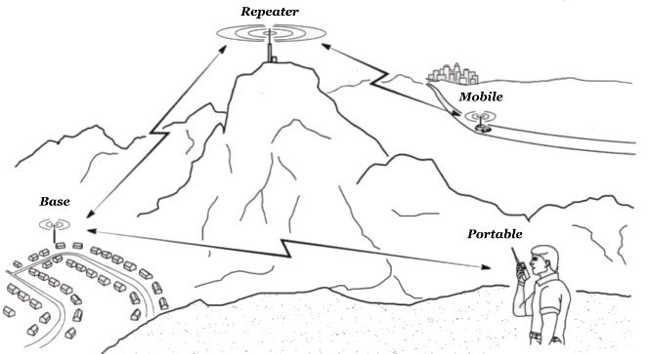
Radio Pod Project
Long term goal of electrical team
Enables real time data transmission from car
Provides GPS data for autonomous team

Slide 3

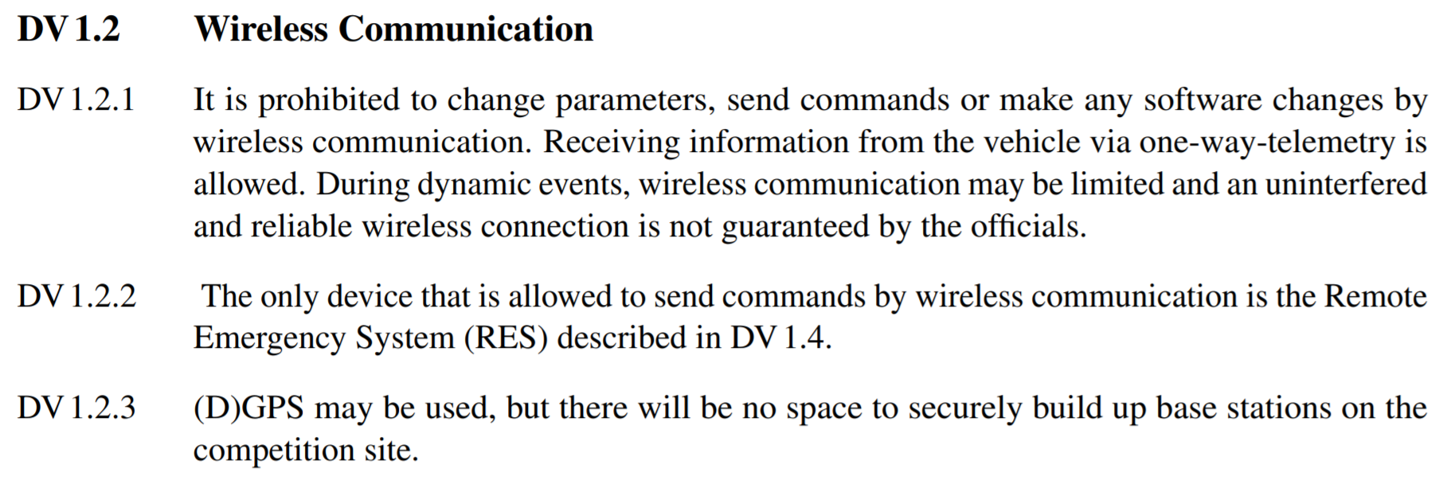
Requirements - Rules

Slide 4
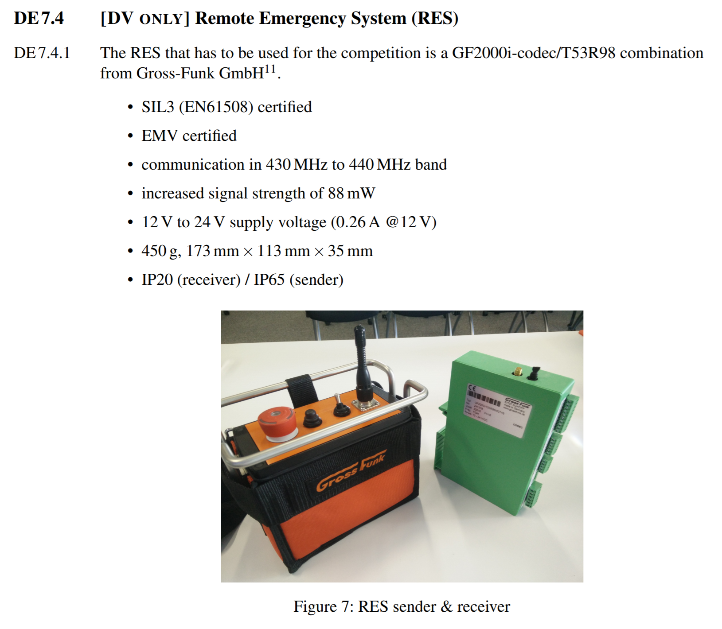
Requirements
- Rules

Slide 5
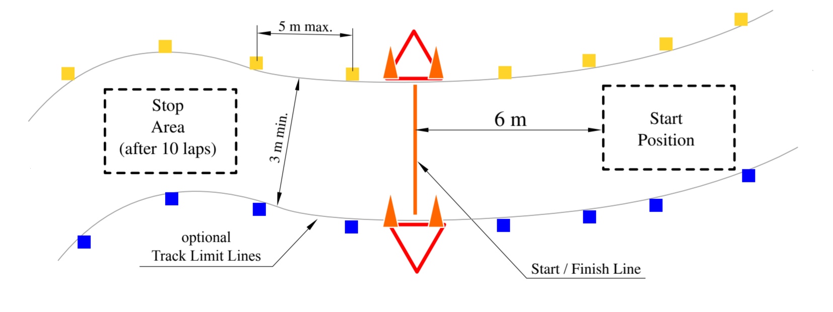
Requirements - GNSS

Slide 6
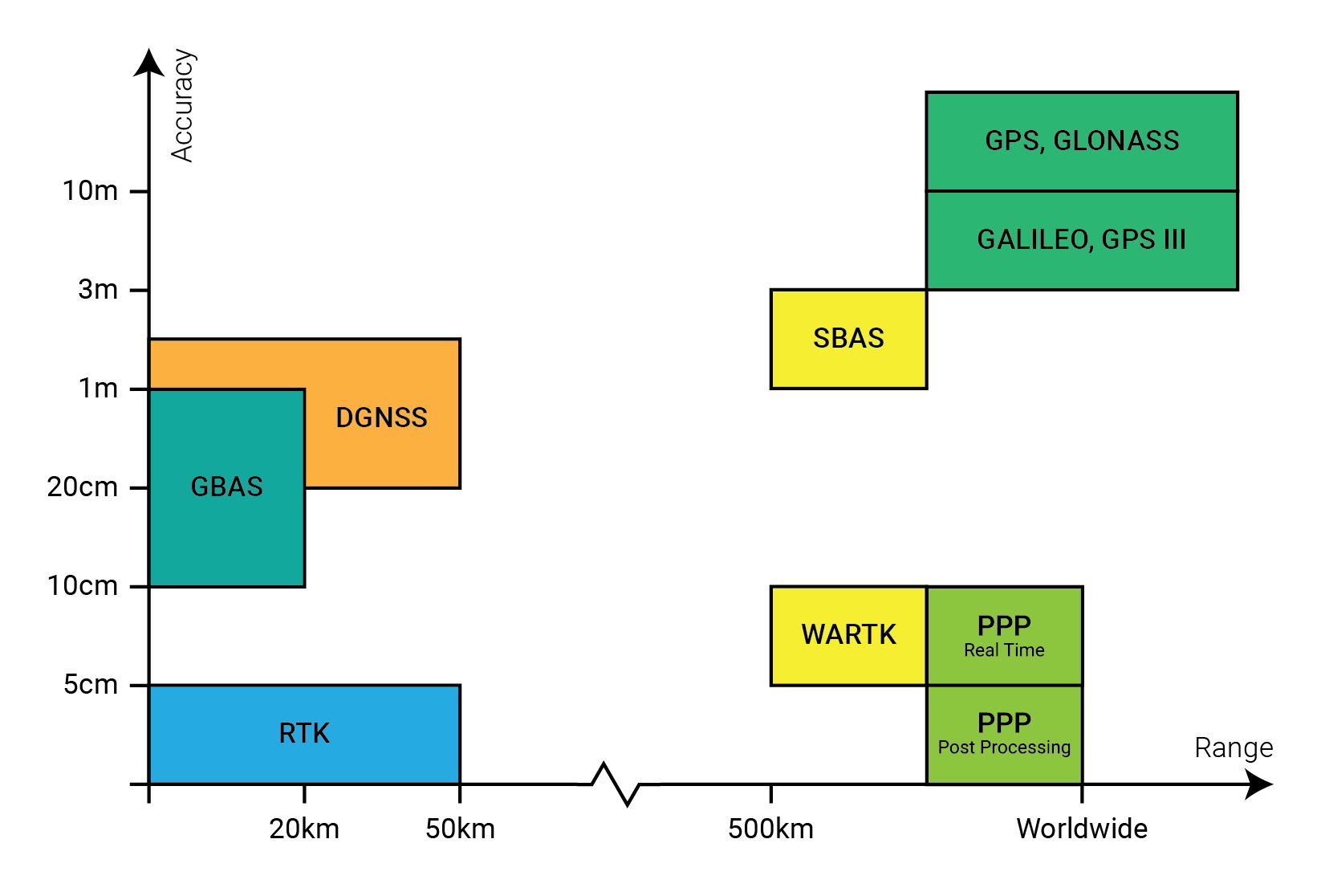
Requirements - GNSS

Slide 7
Requirements - GNSS
Accuracy
Decimeter level (10’s of centimeters)
Required though either:
RTK
Dead Reckoning
PPP (Real Time), a huge amount of processing
Bands
Combined: GPS (Bands I,II,III), GLONASS, BeiDou, GALILEO
Update Speed
10Hz = 10th of a second

Slide 8
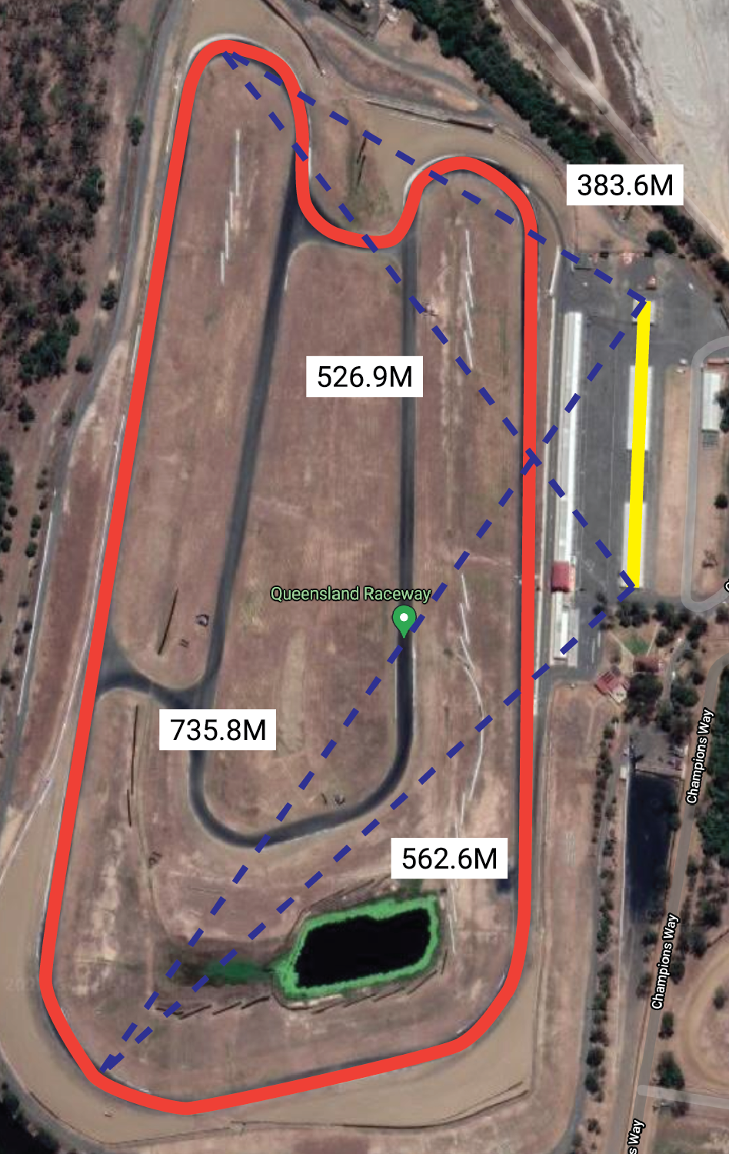
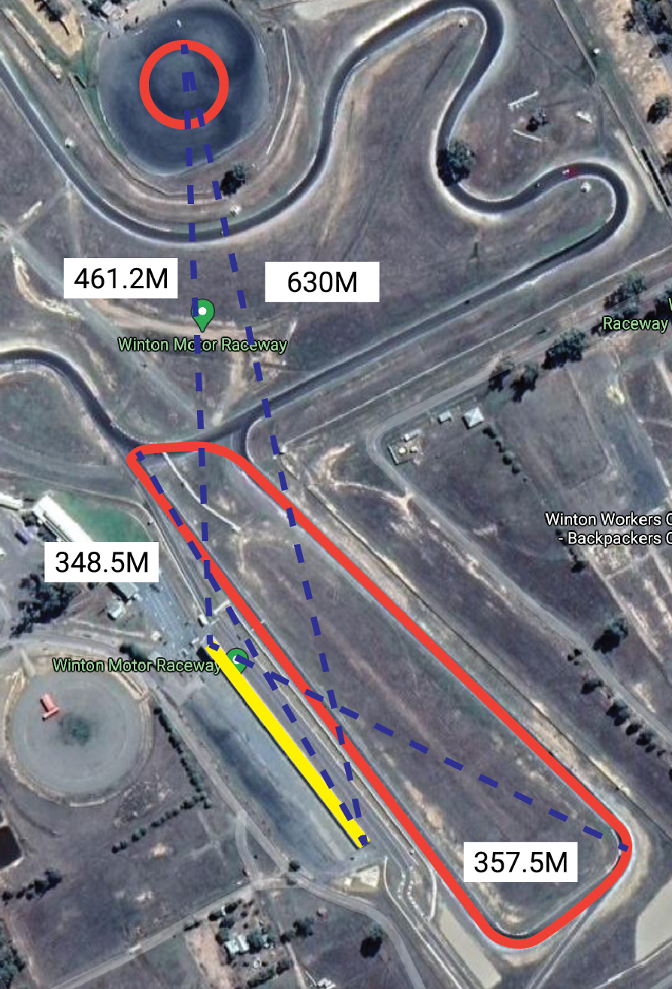
Requirements
- M2M / Data
Transmission

Slide 9
Requirements - M2M / Data Transmission
Datarate
Full CANBUS utilization (85% of a 500k/bit link)
Range
800M minimum, with huge operating window as extra as to guarantee operation
Have to account for antenna occlusion as well
Frequency
900Mhz ideally (better range, inherent noise immunity, suitable datarate)
Power
ACMA / ISM Band specification & legislation = Less than or equal too 1W
Interference
Other teams are assumed to be using the same devices or bands

Slide 10
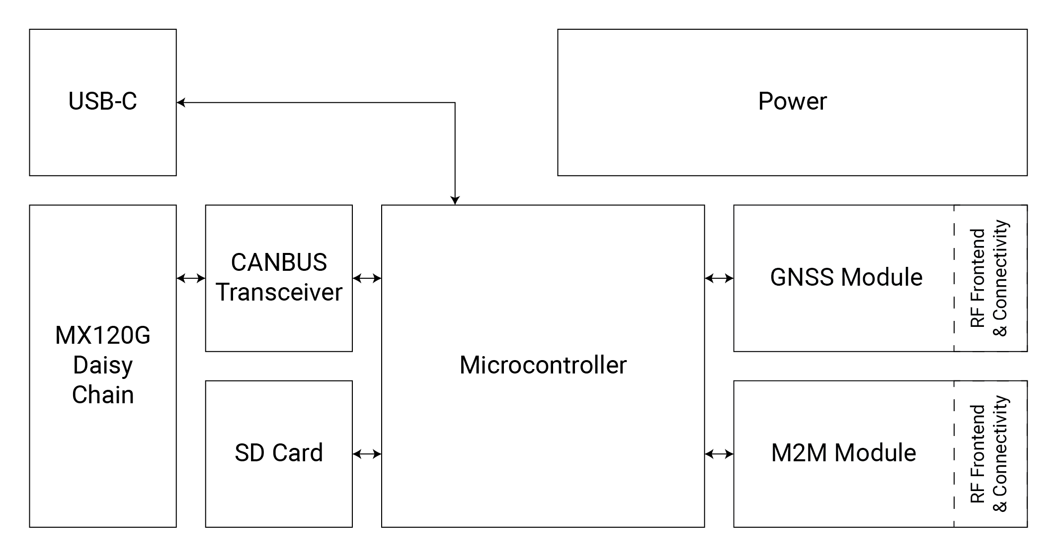
Requirements Architecture

Slide 11

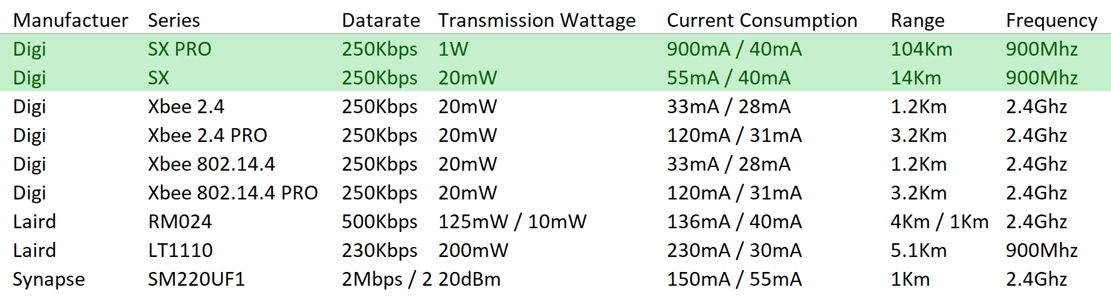



Design – Choice of M2M Radio Module

Slide 12
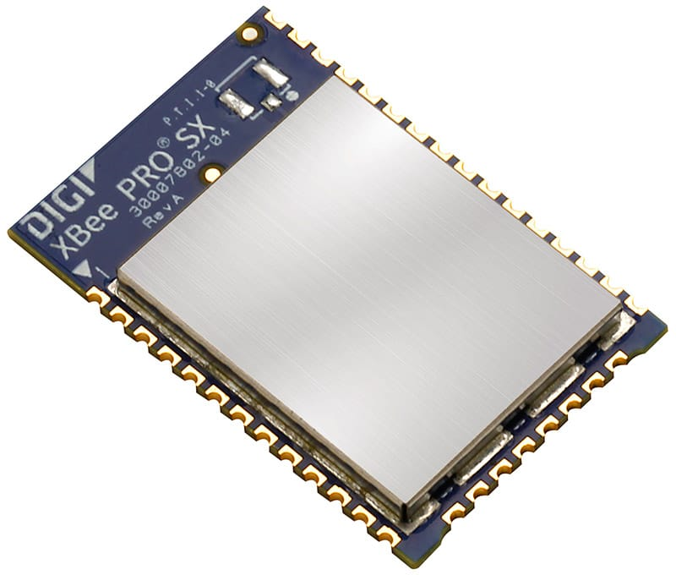
Design – M2M – DIGI SX
Huge Range
SX Series = 10km reliably (20mW)
SX PRO Series = 120km reliably (1W)
Pin compatible between series
High Data rate
200k/bps (assuming correct configuration)
Automatic frequency hopping and channel encryption
Supports XCTU configuration software over USB

Slide 13
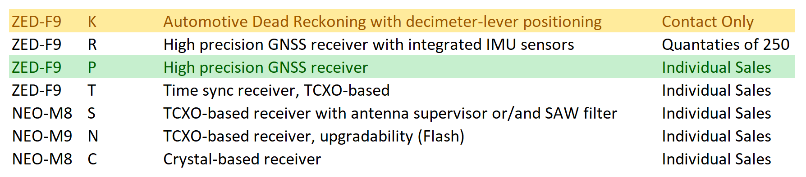

Design – Choice of GNSS Module

Slide 14
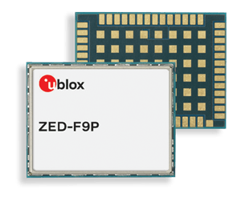
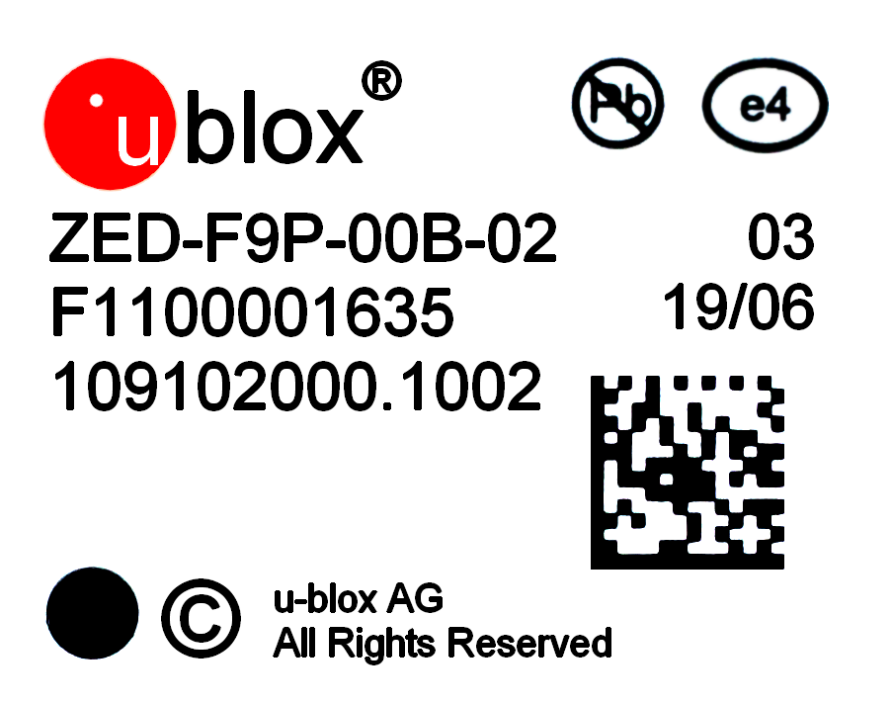
Design – GNSS – ZED-F9P
Ultra high accuracy – out of box 1M accuracy
Supports RTK = with correct antenna, 0.5mm
Support concurrent GNSS connections to multiple constellations
Bands: L2OF, L2C, E1B/C, B2I, E5b, L1C/A, L1OF, B1I
Ultra high accuracy onboard TXCO oscillator (±10ppm)
Support uCenter software configuration over USB
Pin compatible with other ZED-F9# series (incase the K variant becomes available)

Slide 15
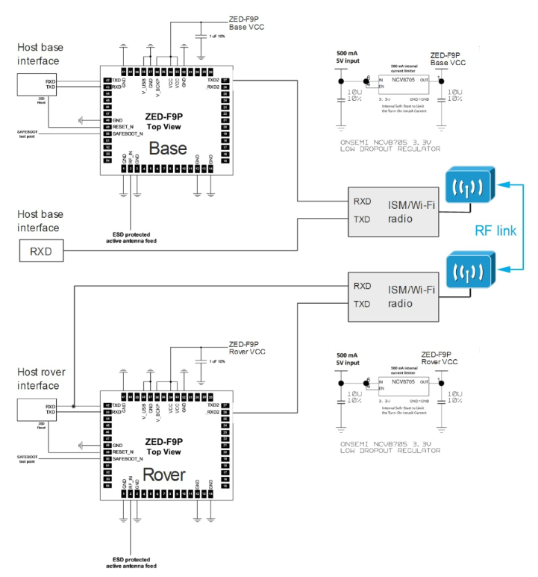
Design – GNSS – RTK Implementation
Two GNSS ZED-F9P modules
Car = Rover configuration Pits = Base station configuration Use M2M Radio link to transmit RTCM packets

Slide 16
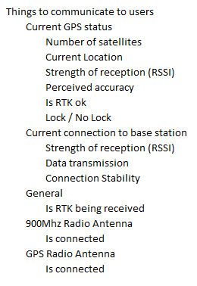
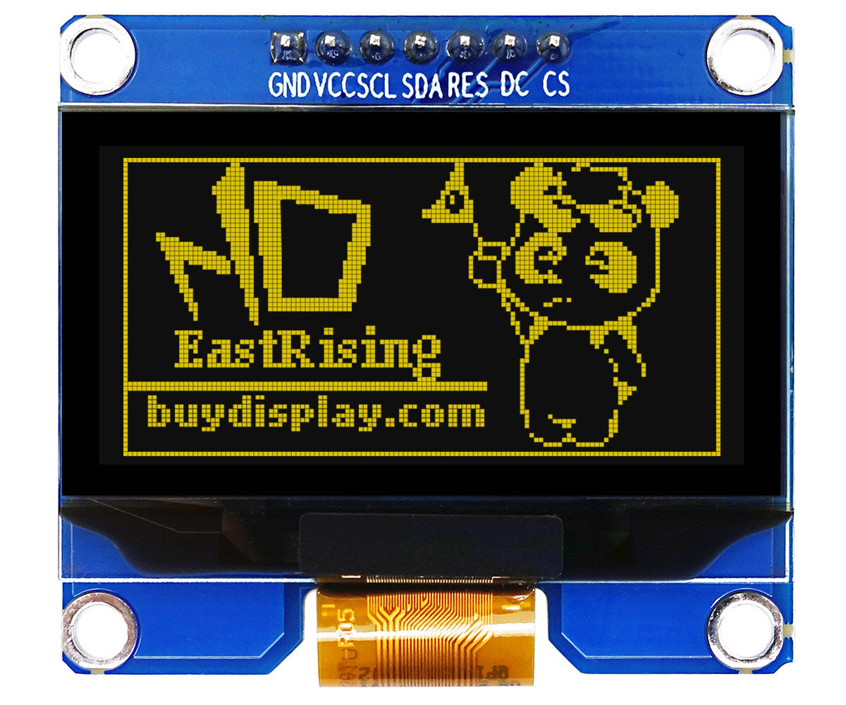
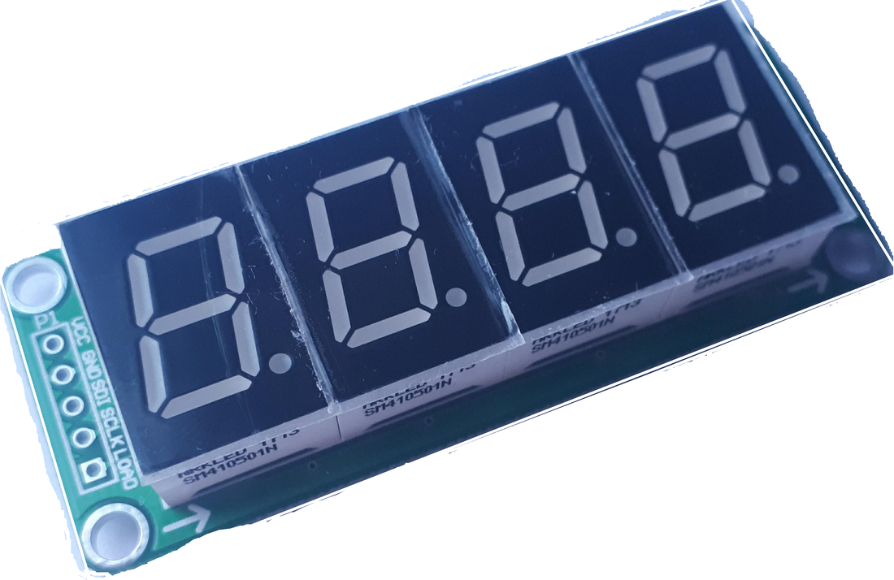
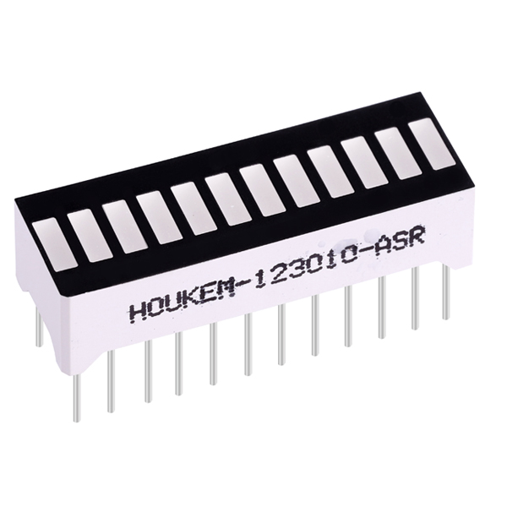
Design – OLED Display

Slide 17
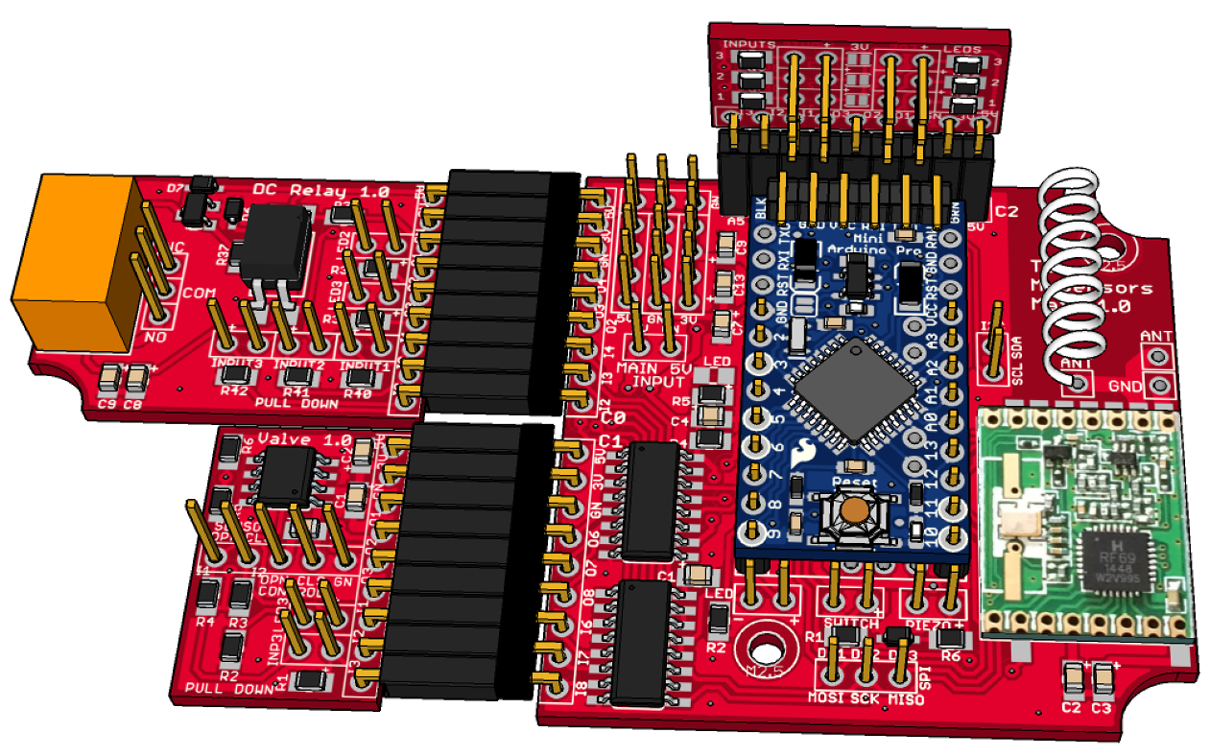
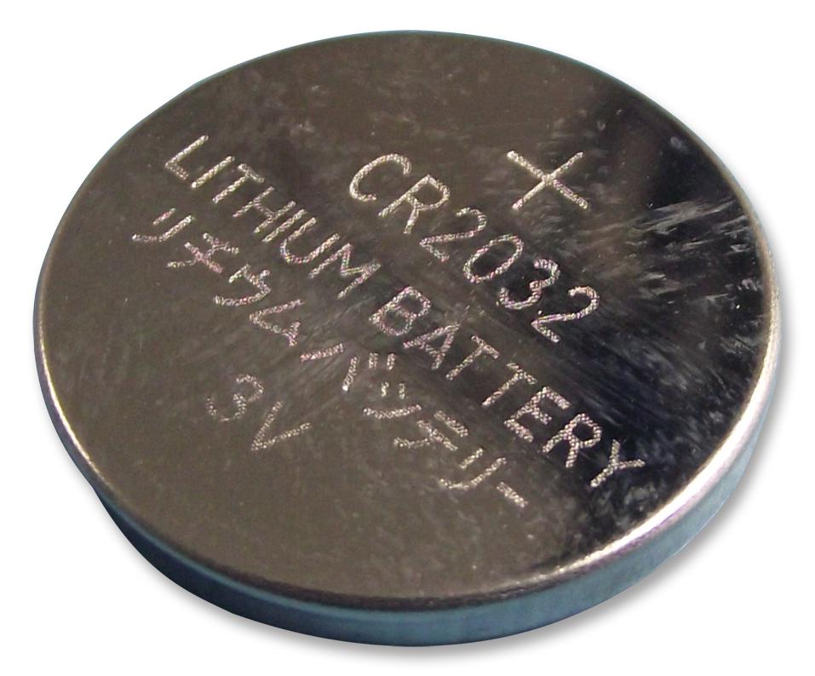
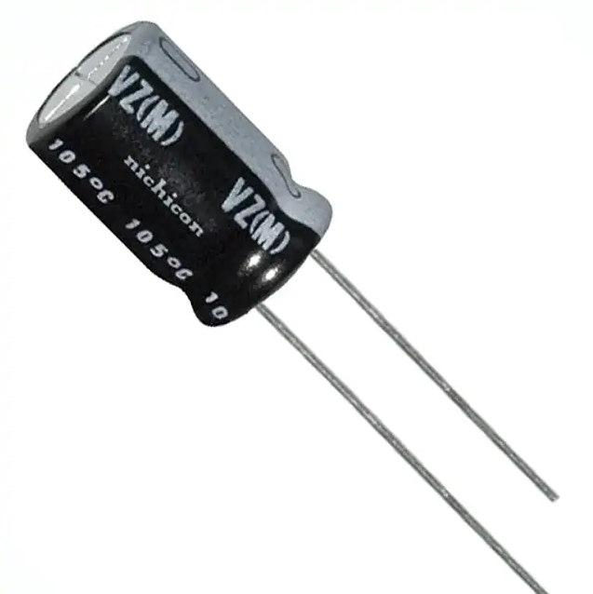
Design Process - Other
Module Design
Backup Batteries
RF Modules high cost Selectively implementable Allows small design changes
MCU Real Time Clock GNSS Module Hot Acquisition

Slide 18
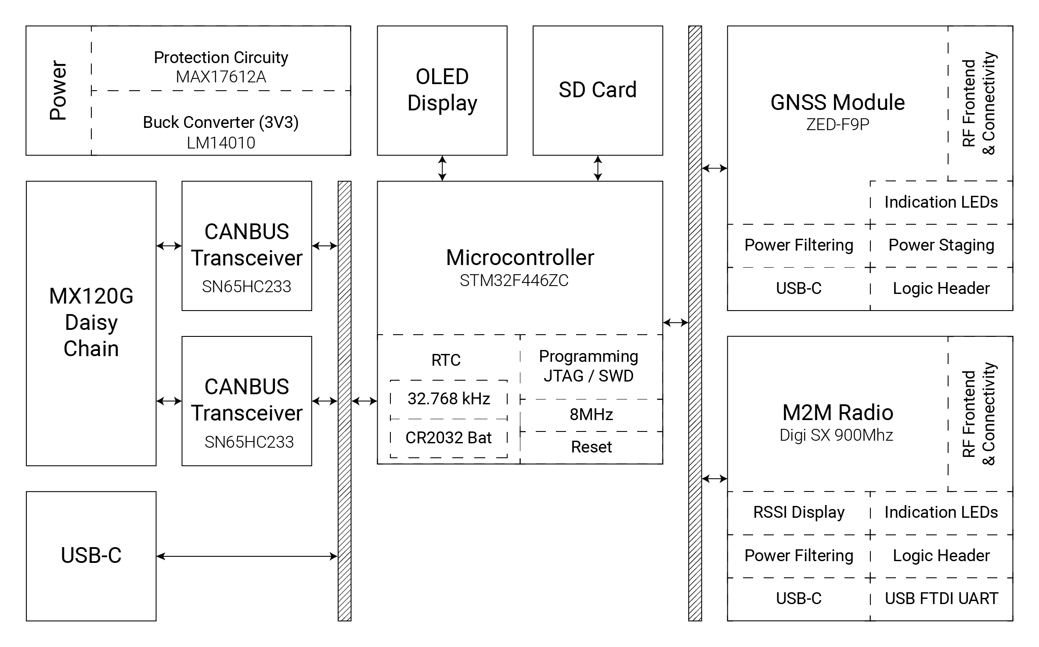
System Architecture

Slide 19
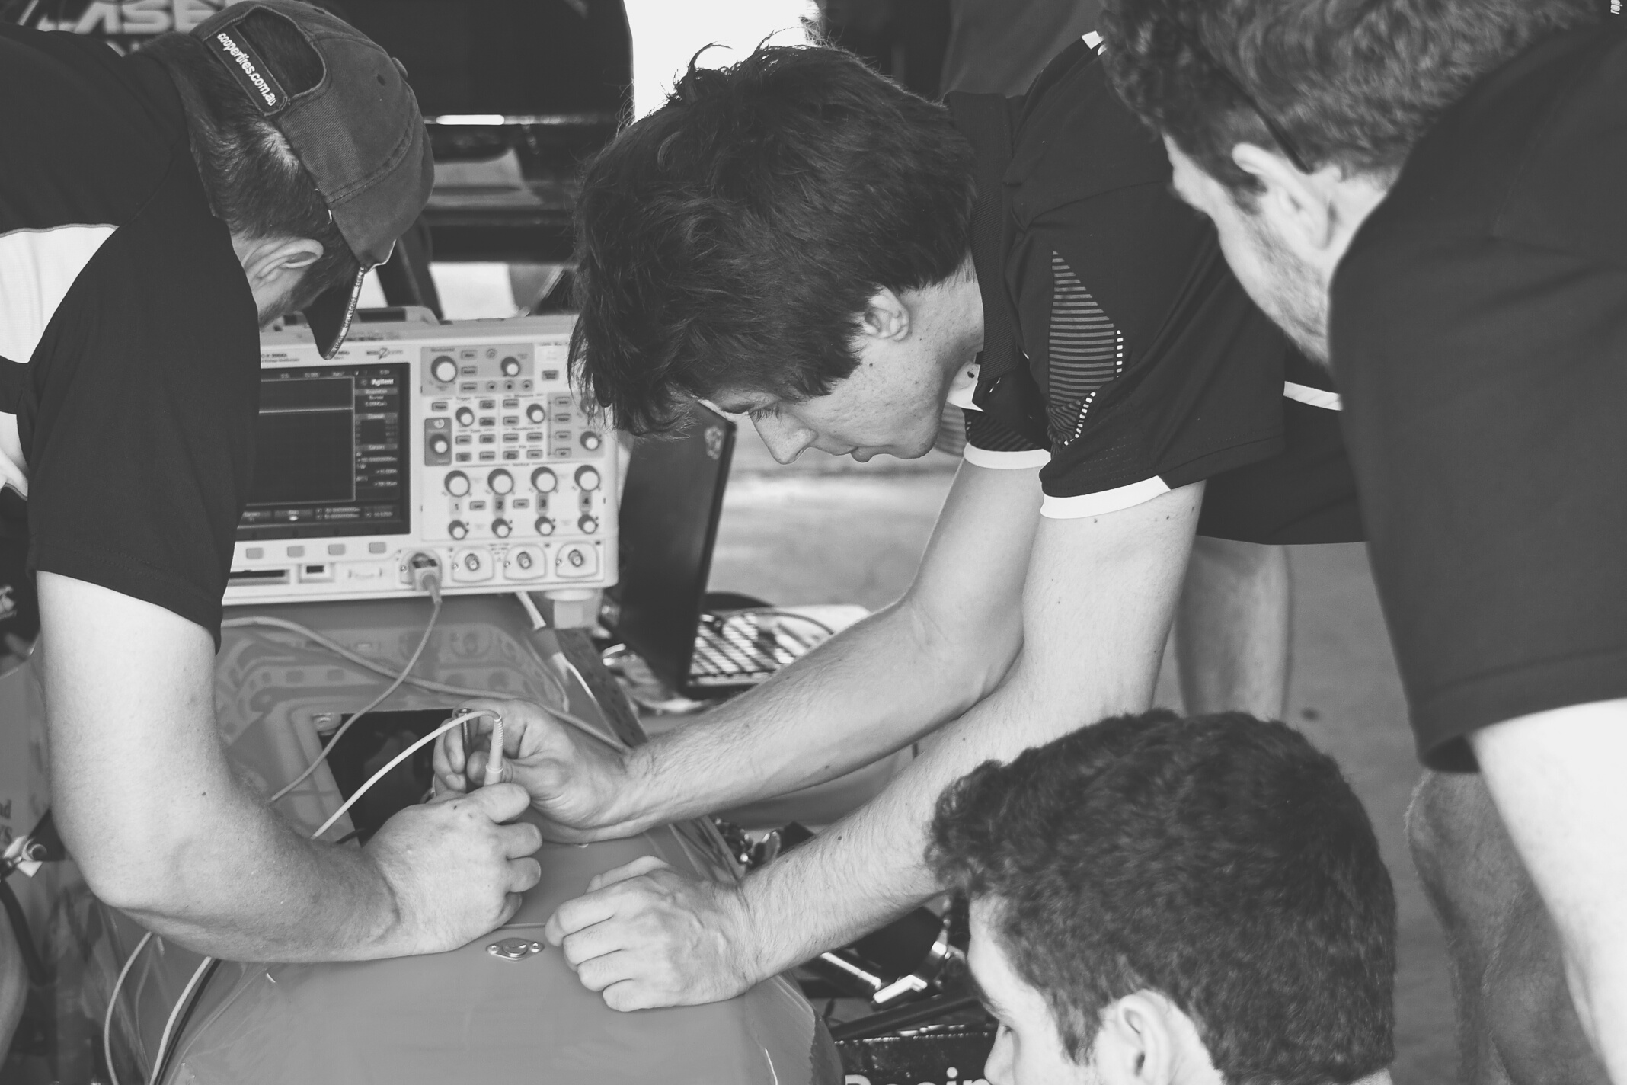
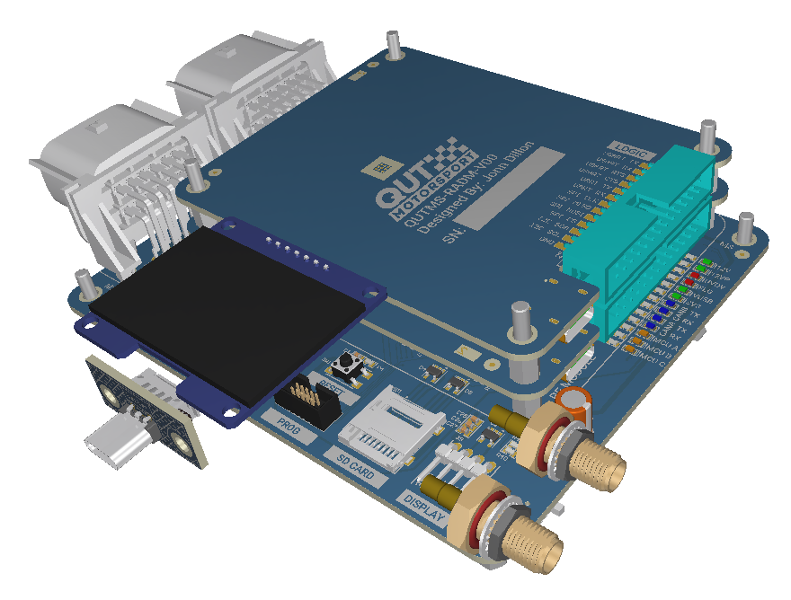
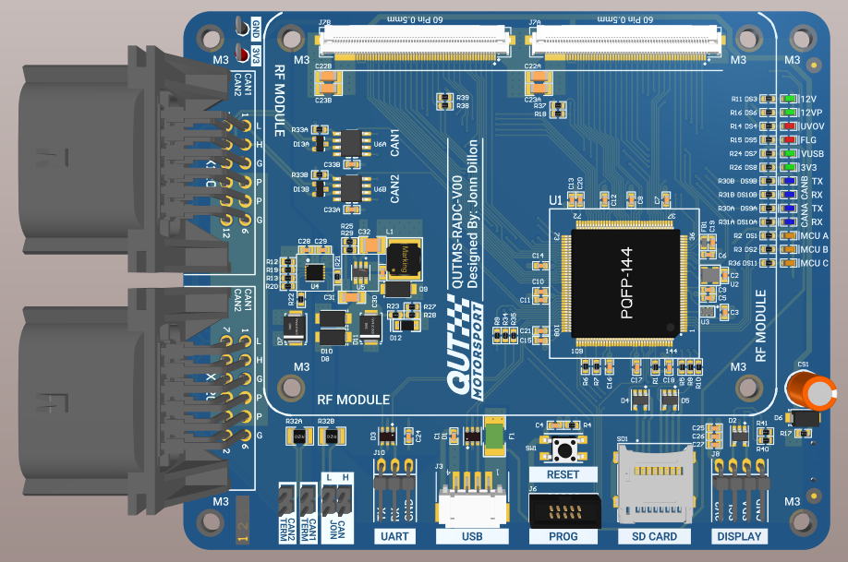
End Result

Slide 20
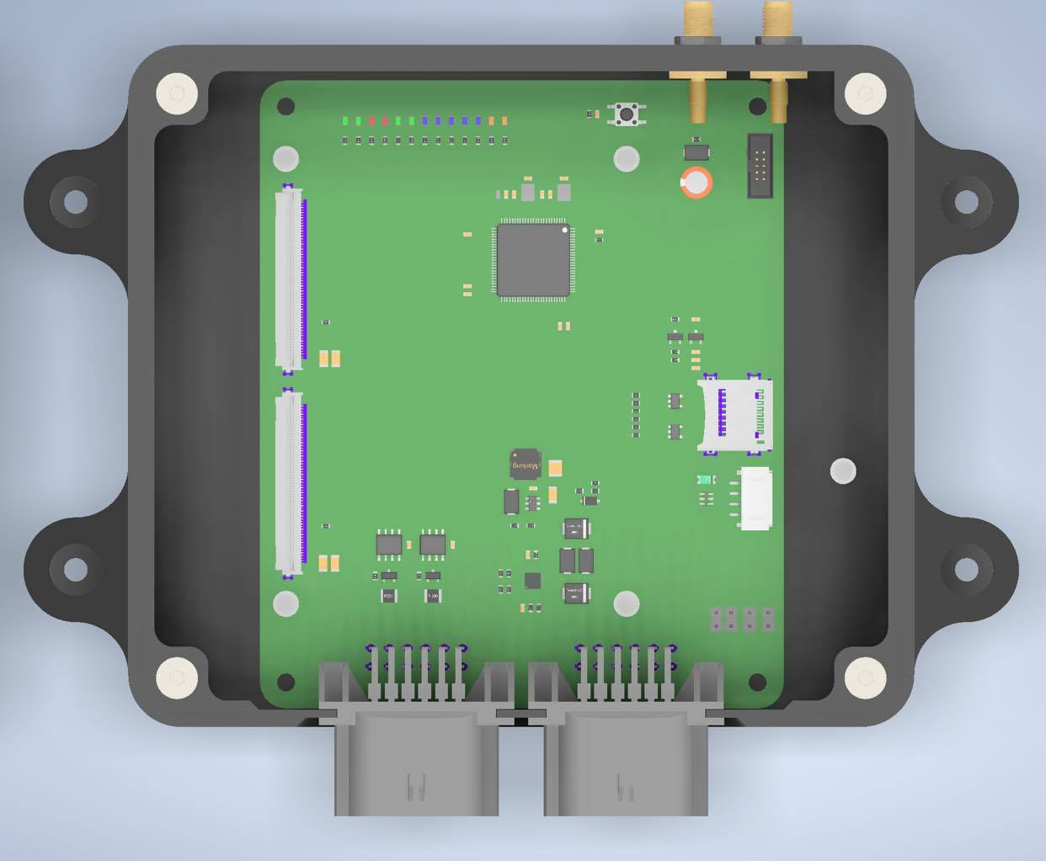
End Result
Completed:
All schematics, Layout of compute board
Incomplete:
Layout of GNSS and M2M boards
Antenna selection and mounting
Limitations:
Potentially data rate
Potentially base station establishment

Slide 21

Conclusion

